Slide 1

WELCOME

Slide 2


Introductions
Keisha McCarden, Realtor
Quinesha “Nikki” Hawkins, Realtor Specializing in Commercial Real Estate and Development

Slide 3
Mission Statement
Empowering communities through strategic investments, our mission is to cultivate prosperous opportunities and sustainable growth in the real estate landscape. With integrity, innovation, and a commitment to excellence, we aim to deliver unparalleled value to our stakeholders while positively impacting the neighborhoods we serve.

Slide 4

What is a REIT?
A real estate investment trust (“REIT”) is a company that owns, operates or finances income-producing real estate. REITs provide an investment opportunity, like a mutual fund, that makes it possible for everyday Americans—not just Wall Street, banks, and hedge funds—to benefit from valuable real estate, present the opportunity to access dividend-based income and total returns, and help communities grow, thrive, and revitalize.
(reit.com)

Slide 5
How does a company qualify as a REIT?
To qualify as a REIT a company must:
Invest at least 75% of its total assets in real estate
Derive at least 75% of its gross income from rents from real property, interest on mortgages financing real property or from sales of real estate
Pay at least 90% of its taxable income in the form of shareholder dividends each year (Quarterly Payouts)
Be an entity that is taxable as a corporation
Be managed by a board of directors or trustees
Have a minimum of 100 shareholders
Have no more than 50% of its shares held by five or fewer individuals (reit.com)

Slide 6
WHO SHOULD INVEST?
This is for LONG TERM INVESTORS ONLY!
People looking to get into real estate investing that may not have the capital alone to do so.
Like minded individuals.
You must be willing to invest for 3 years or more.
Must be willing to reinvest some dividends to keep the trust going!
People looking for passive income. Let your money work for you!
This NOT a get rich quick scheme.

Slide 7
Pay at least 90% of its taxable income in the form of shareholder dividends each year (Quarterly Payouts)
EXAMPLE ONLY! (Based on 100 investors - Not Guaranteed Rates):
Year 1 Profits :$30,000 (90% share) = $75 each quarter ($300 year)
Year 2 Profits: $60,000 (90% share) = $150 each quarter ($600 year)
Year 3 Profits: $90,000 (90% share) = $225 each quarter ($900 year)
Year 4 Profits: $120,000 (90% share) = $300 each quarter ($1200 year)
The remaining 10% will be used in paying any fees/taxes and reinvesting in more properties.
As more investors come on more properties will be acquired.
Year one and year two investment will be $1000.
Entry to REIT will increase after year 2.

Slide 8

THE WAY TO GET STARTED IS TO QUIT TALKING AND BEGIN DOING.
Walt Disney

Slide 9
Existing Real Estate Investment Trusts
Tanger Inc. (They own a few outlet malls and other properties.)
Simon Property Group Inc (They own Treasure Coast Mall and other malls in South Florida and in the US.)
Invitation Homes (They own several rental home properties in Florida and surrounding states.)
Public Storage (Self-Storage)
Cube Smart (Self-Storage)
First Key Homes (They own several rental home properties in Florida and surrounding states.)

Slide 10



What’s Next:
POSITIONS OPEN NOW FOR BOARD MEMBERS
LOOKING FOR BOARD MEMBERS WHO WILL BE READY TO START IN SEPTEMBER
Retain an Attorney ✓
Business Entity will be created.
Monthly Investor Meetings
Monthly Onboarding Investor Meetings
Facebook Group Page will be created ✓
https://www.facebook.com/share/CftZYVs6kbtVKuZP/
LEARN MORE:
reit.com (official business website)
YouTube: Commerical Property Advisors
YouTube: R&G #15: HOW TO INVEST IN REITS WITH WALLSTREET TRAPPER
https://youtu.be/25TNJZnEbXM?si=BAsnQHkAl3uMRMHt
https://youtu.be/ohRhfcCCCGY?si=vPCaJQGU2L2tYg58

Slide 11
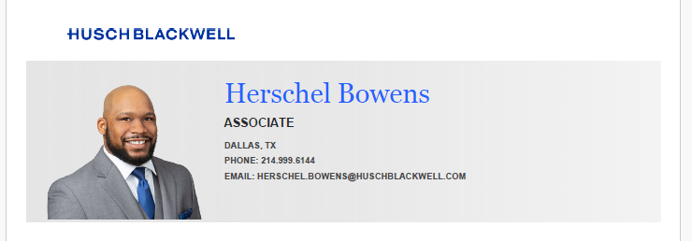
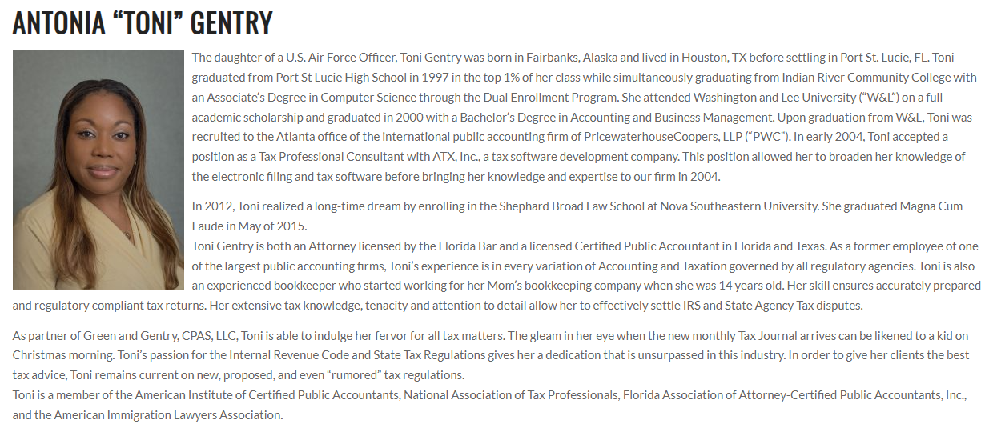
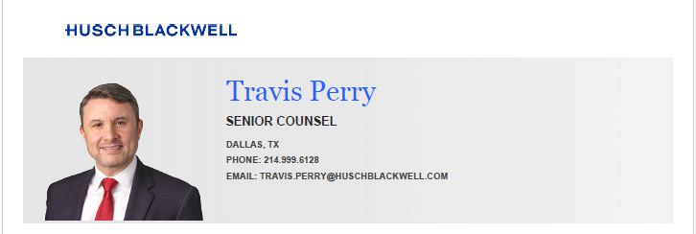
Meet The Team
Husch Blackwell
Green & Green Certified Public Accountants
C:\Users\keish\OneDrive\Desktop\KLM\Herschel Bowens Bio.pdf
https://www.gandgcpas.com/about-us/antonia-toni-gentry/
C:\Users\keish\OneDrive\Desktop\KLM\Travis Perry Bio.pdf

Slide 12


Q & A Session
Thank You

